Slide 1
Detection and Automatic Gain Control

Slide 2
Diode Detector
A diode detector is the far most common devices for amplitude demodulation or detection.
On this circuit, there is a small capacitance, C. A large resistance R.
The parallel combination of R and C is the load resistance across which the output voltage V0 developed.

Slide 3
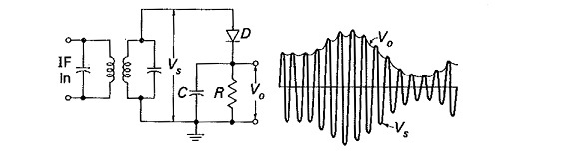
Diode Detector Circuit
A Simple Diode Detector

Slide 4
Diode Detector- why used?
The diode detector is the simplest form of detector or demodulator used for AM demodulation – it detects the Amplitude modulation signal envelope. The diode detector is the simplest and most basic form of amplitude modulation, Amplitude modulation signal detector and it detects the envelope of the AM signal.

Slide 5
Automatic Gain Control
AGC is a system that controls the increase in the amplitude of an electrical signal from the original input to the amplified output, automatically. AGC is used in data processing to improve the visibility of data.

Slide 6
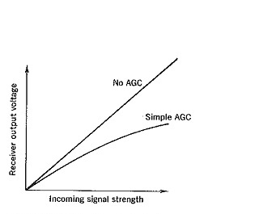
Automatic Gain Control Graph
Simple Automatic Gain Control Graph

Slide 7
Automatic Gain Control Principals
Working Principle of Automatic Gain Control is a system by means of which the overall gain of a radio receiver is varied automatically with the changing strength of the received signal, to keep the output substantially constant.

Slide 8
Thank You

